Slide 1
Business Readiness
TRACES.NT Registration Process

Slide 2
Contents
How to register – Organisation administrator
How to register – Standard user
How to authorise a Standard user

Slide 3
How to register for TRACES.NT – Organisation administrator

Slide 4
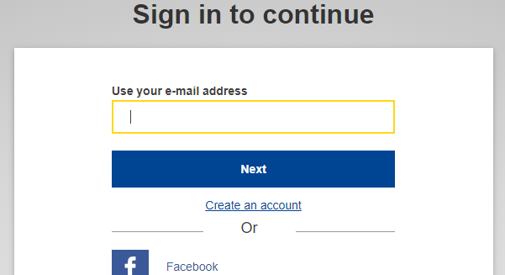
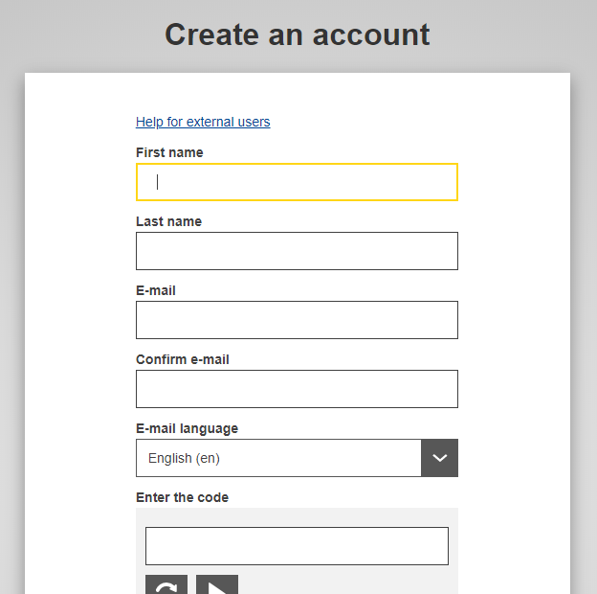
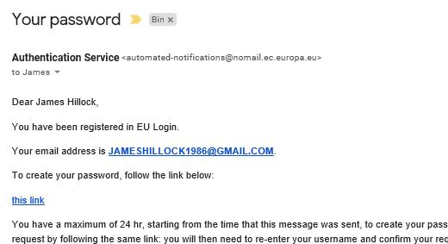
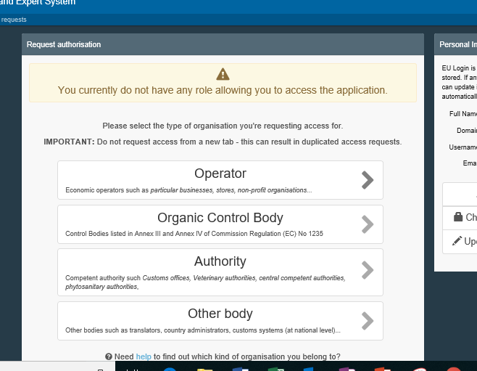
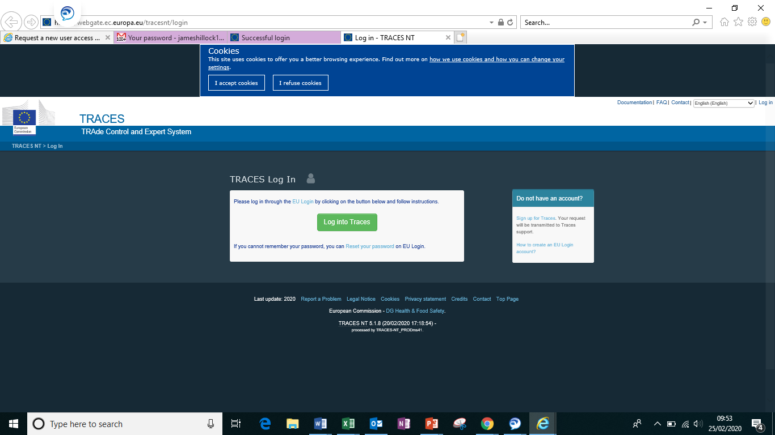
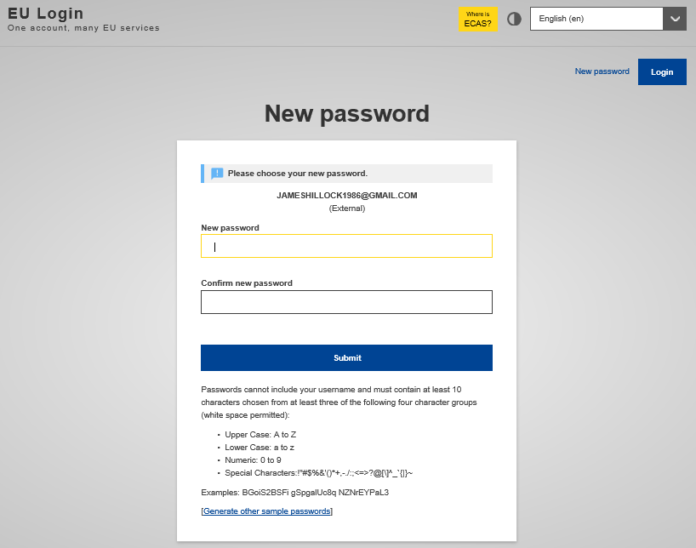
How do I register for TRACES.NT? – Org Admin
Select ‘Create an account’
Enter your info
01
02
03
Validate Email Details
Hint: Please note your email needs to be unique and can only be
registered once. You are unable to use a shared or collective
Email address.
Hint: Please check your junk / spam folder if code not
received within 2 hours.
Enter the link for Traces NT in
your browser
06
Select Operator
05
Create a password
04
Hint: Once you have loaded the Traces NT website into your browser you
will see this screen.
Hint: Once you have created a password you can proceed
  through the next two screens.

Slide 5
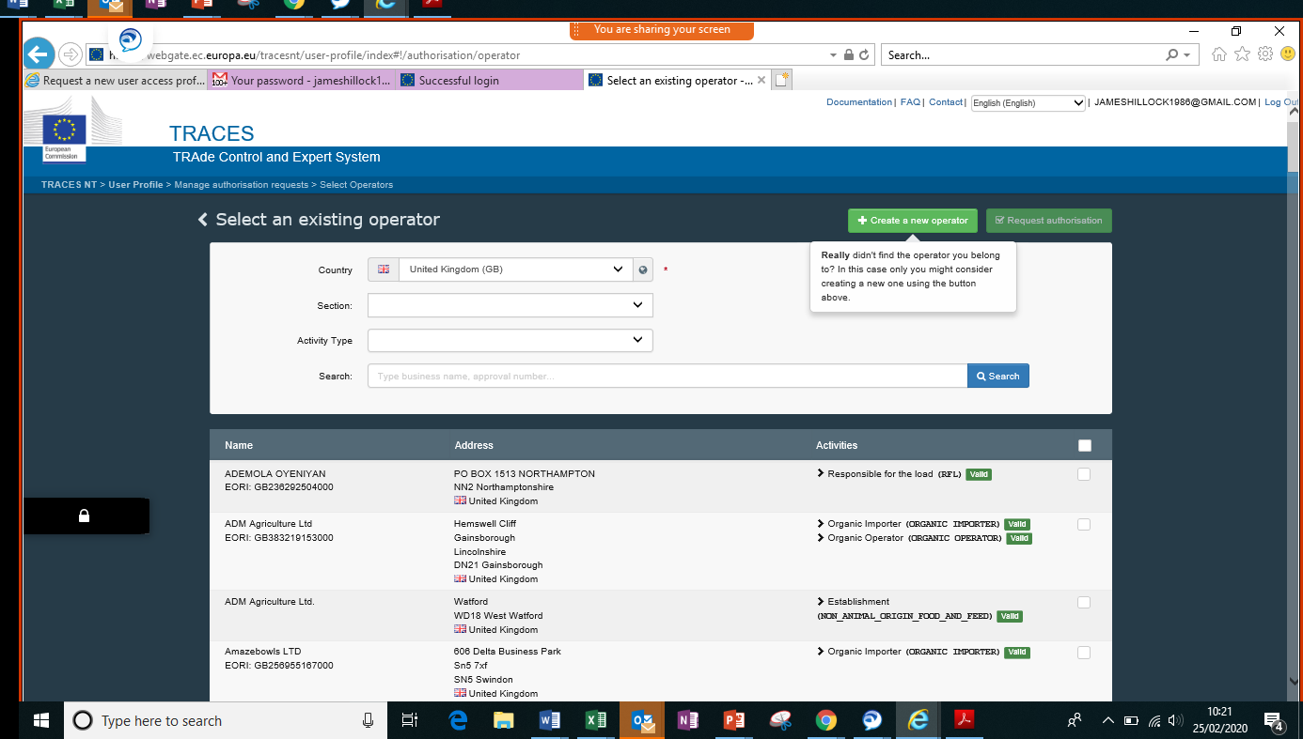
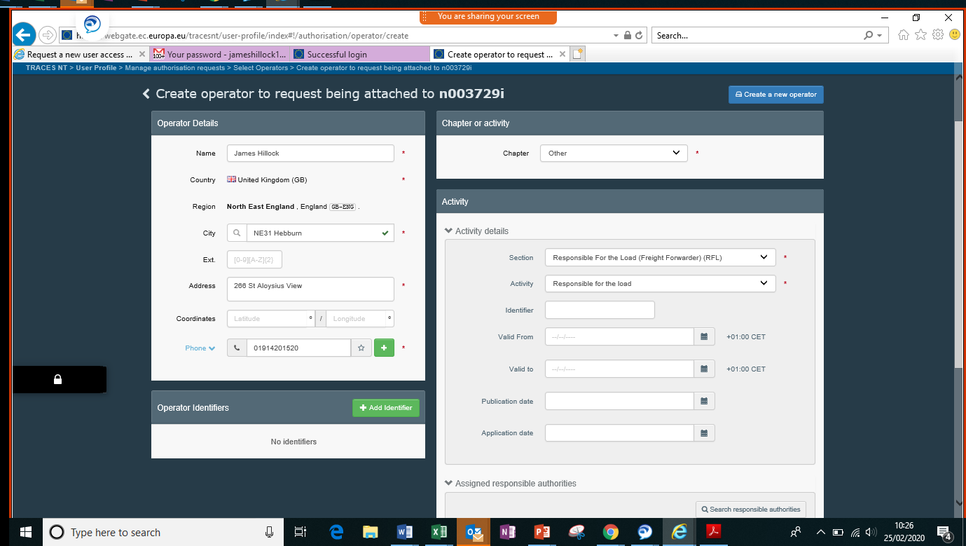
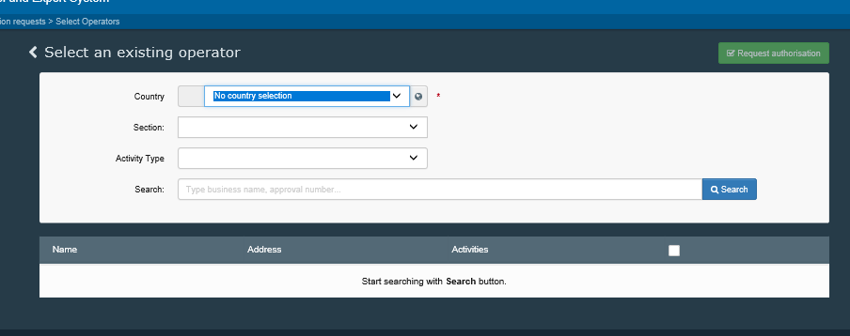
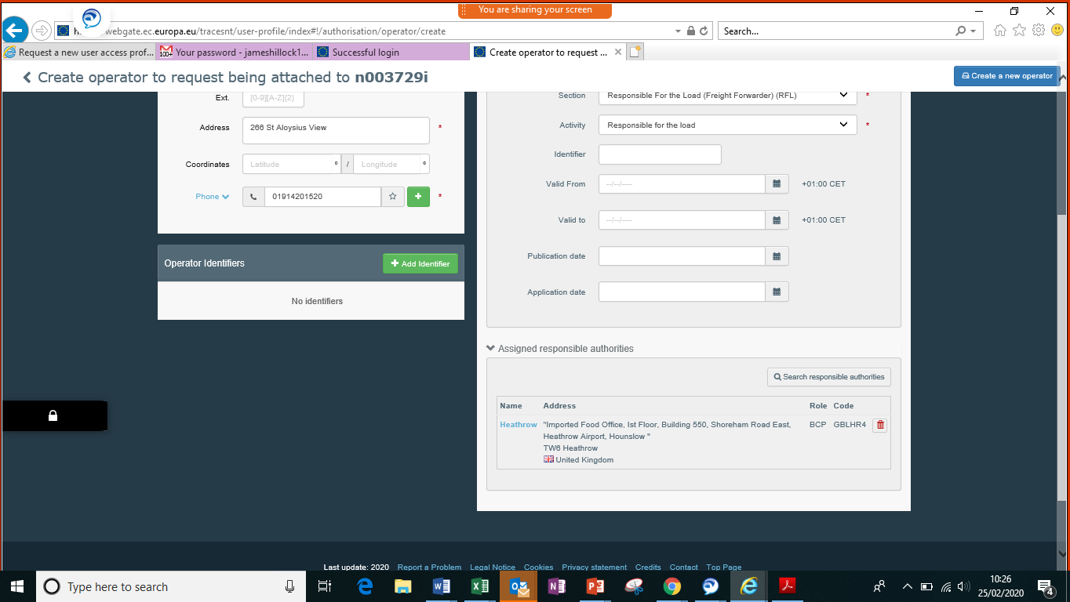
Registrations continued…
Now click ‘Create a new operator’
7
Click ‘Search’
08
09
Enter your ‘Operator details’
Hint: In order to create a new RFL account you must first check that
your organisation does not already have an account. If you are setting
your organisation up for the first time you can simply click search.
Hint: Remember the first person to register your organisation
will hold the ‘Admin’ position and will be able to validate other users
to your organisation.
Hint: Fill out the information of your organisation, this
should identify your business and not you personally.
12
Scroll down to ‘Assigned responsible authority’
11
10
In Activity update ‘Selection’ and ‘Activity’
In ‘Chapter or activity’ select ‘Other’
Hint: You must select the BCP you operate through most often, or the
one you have a relationship with. This BCP will be the organisation
who authorises your Traces NT account. You need to select the BCP
relevant to the commodity you import, i.e. Animal = CHED-A.
Hint: Both the ‘Selection’ and the ‘Activity’ box should state Responsible
for the Load. The remaining boxes in the Activity section can be left blank.

Slide 6
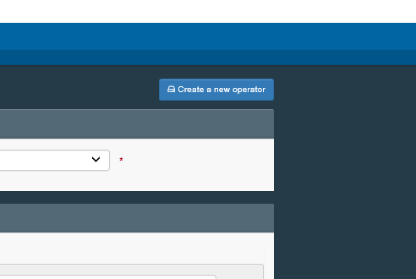
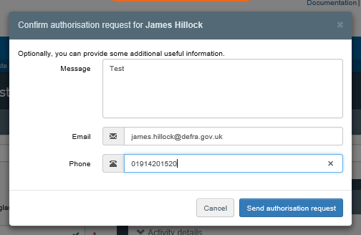
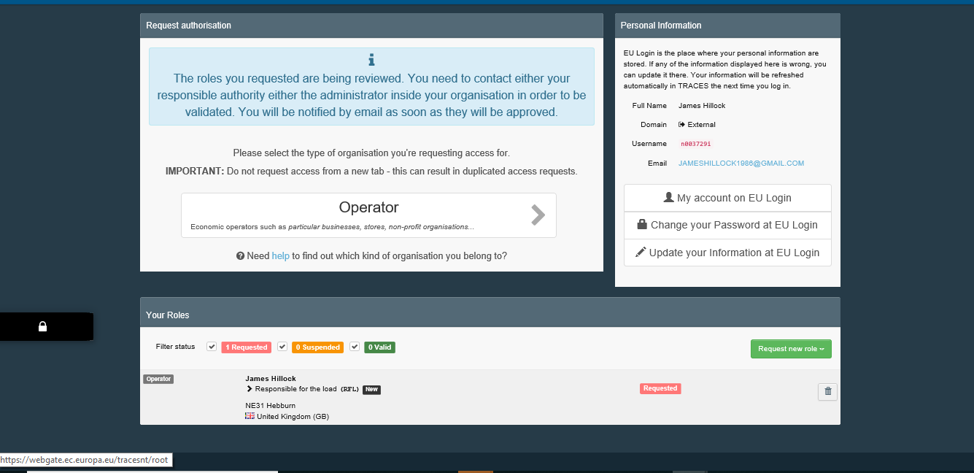
Registrations continued…
Click ‘Send authorisation request’
13
Scroll up and select ‘Create a new operator’
14
15
Contact your BCP
Hint: The information entered in in this section will
not be visible to the BCP.
Hint: You should now make contact with the BCP you
selected as the assigned responsible authority in step
12. This is the authorisation who will validate your account.

Slide 7
How to register for TRACES.NT – Standard user

Slide 8
How do I register for TRACES.NT? – Standard user
Select ‘Create an account’
Enter your info
01
02
03
Validate Email Details
Hint: Remember the first person to register your organisation
will hold the ‘Org Admin’ position and will be able to validate other users
to your organisation.
Hint: Please note your email is unique an can only be
registered once .
Hint: Please check your junk / spam folder if code not
received within 2 hours.
Enter the link for Traces NT in
your browser
06
Select Operator
05
Create a password
04
Hint: Once you have loaded the Traces NT website into your browser you can
Hint: Once you have created a password you can proceed
  through the next two screens.

Slide 9
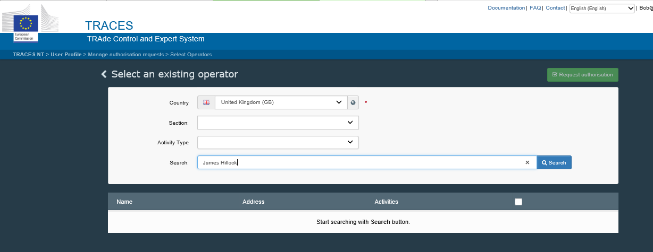
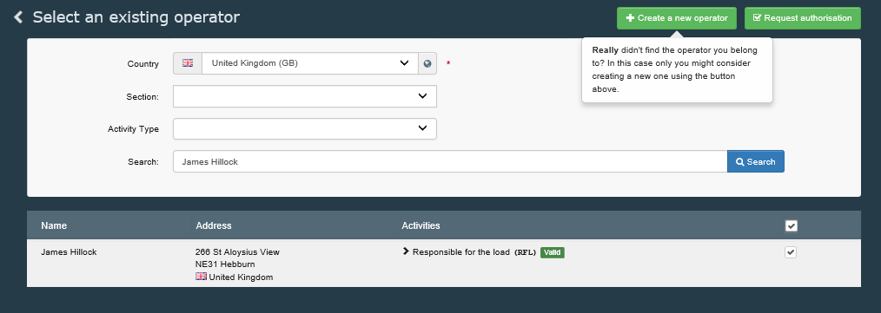
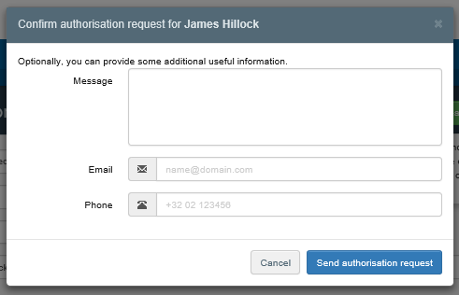
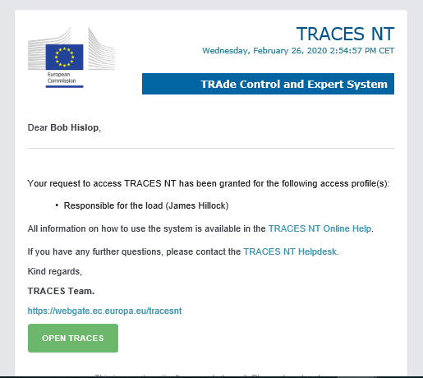
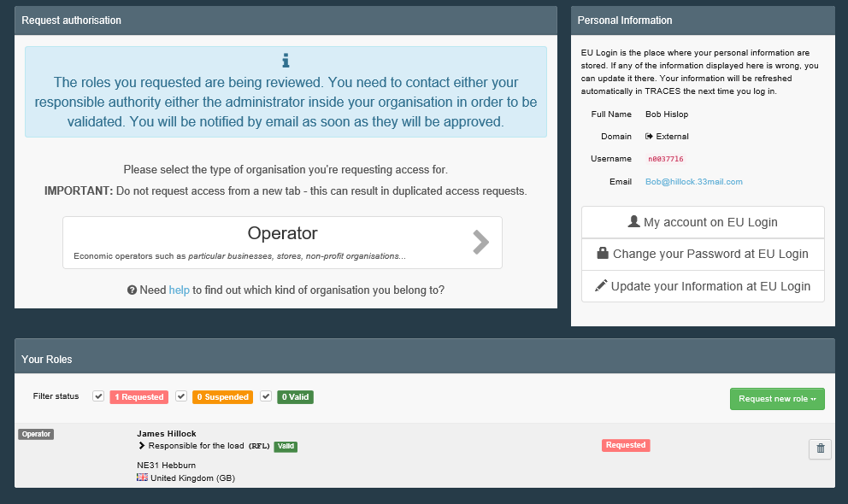
continued…
Tick the box next to your organisation
& click the ‘Request authorisation’ button
Click ‘Send authorisation request’
7
Enter your organisation details & ‘Search’
08
09
Hint: If you don’t find your organisation it may not be correctly setup
ask your org admin to confirm the name of your organisation
Hint: You can enter a message, email, phone number
but it is not essential.
Let your org admin know you’ve raised
a request for access
10
You will receive a confirmation email
11
Hint: The email will confirm you have access to your
Organisations account.
Hint: Your request will pend until the org admin authorises
your request.

Slide 10
How to authorise a Standard user

Slide 11
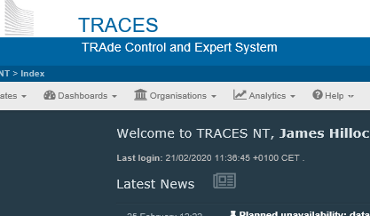
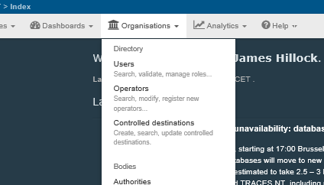
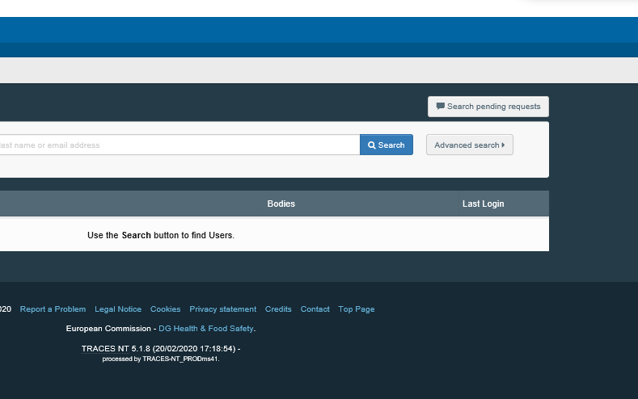
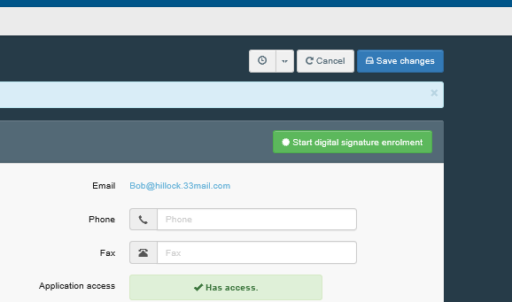
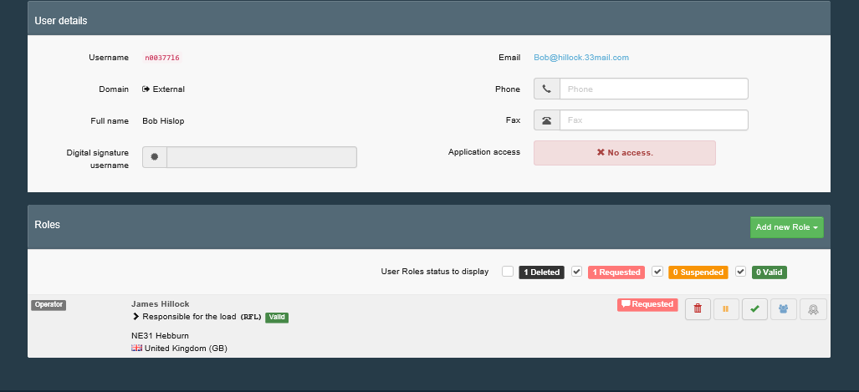
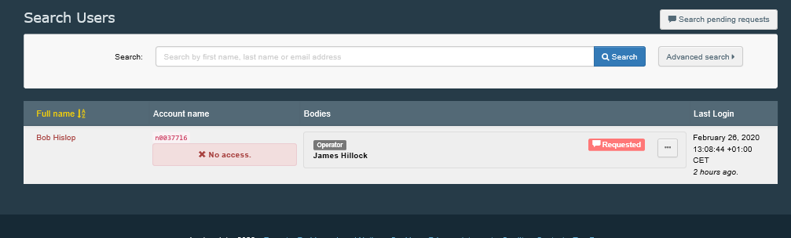
How do I authorise a Standard user?
Select ‘Organisations’
Then select ‘Users’
01
02
03
Click on ‘Search pending requests’
Now click ‘Save changes’
05
Select the person you want to authorise
06
Click the tick to authorise the person
04
Hint: Click on the individuals name to select them.

