Slide 1
Business Readiness Registration Journey – Org Admin

Slide 2
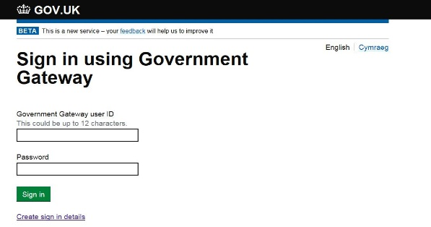
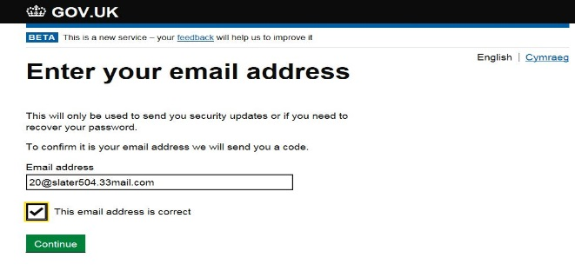
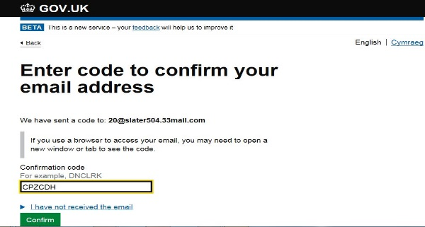
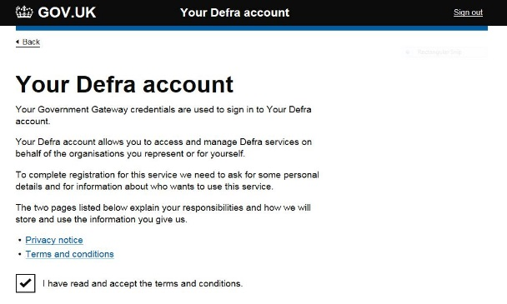
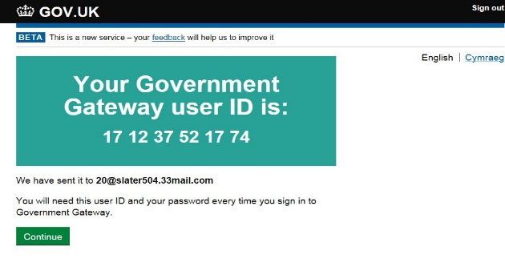
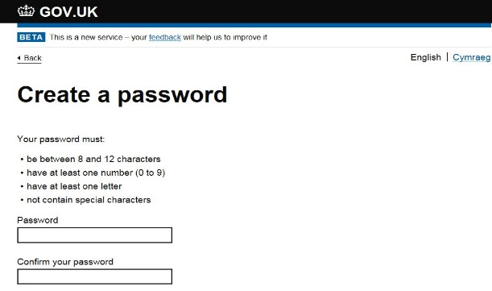
How do I register for IPAFFS? – Org Admin
01
Create a Government Gateway Account
Provide Email Details
Validate Email Details
Select ‘Create Sign in Details’
02
03
Hint: Please note your email is unique an can only be
registered once .
Hint: Please check your junk / spam folder if code not
received within 2 hours.
Hint: Remember the first person to register your organisation
will hold the ‘Org Admin’ position and will be able to invite other users
to your organisation and also to allocate roles.
We highly recommend that you have multiple ‘Org Admins’ within
your organisation
Now register for IPAFFS
05
06
Receive Government Gateway ID
Create a Password
04
Hint: Once you have read ‘T&C’s’ and ‘Privacy Notice’
you will then go on to create your Defra Account
Hint: Once you have created your recovery word you will
receive a unique Government Gateway ID.
As with your password you will need to make a note of
your Government Gateway ID (this will be your user ID
when logging into IPAFFS) and save in a secure place
Hint: You will also be asked to create a recovery word in
Addition to a password.
Remember to make a note of your password and
recovery word as this will be required each time
you access IPAFFS

Slide 3
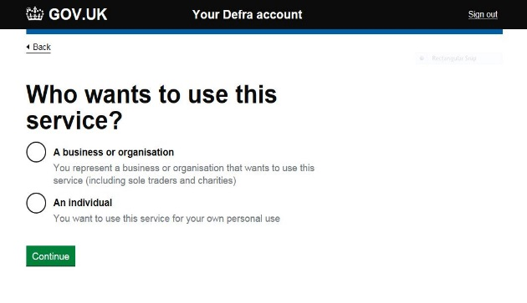
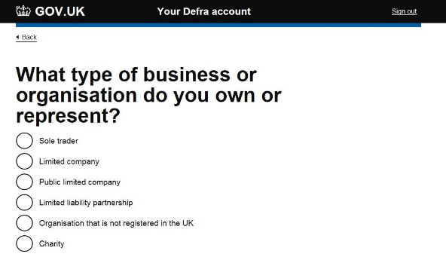
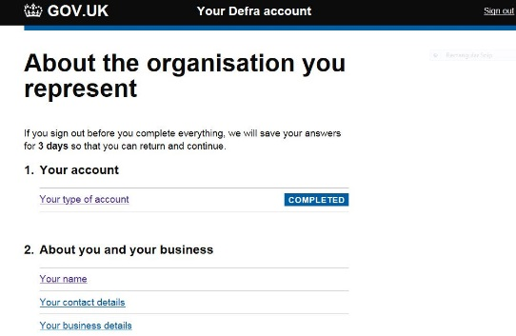
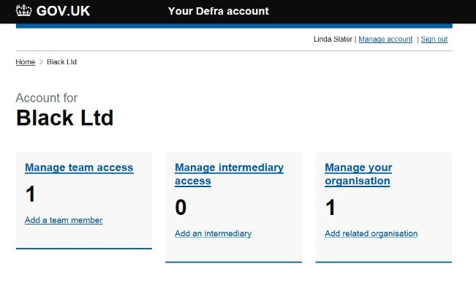
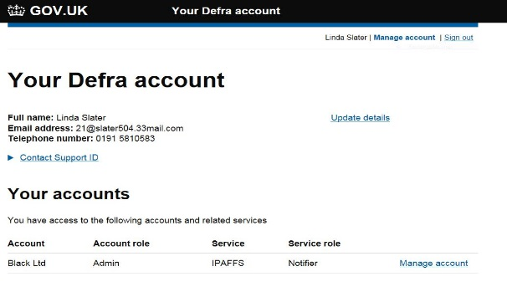
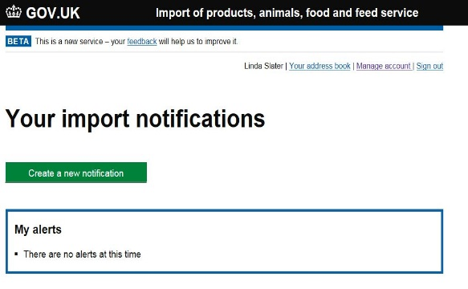
Registrations continued…
Choose Type of Business
07
Choose Type of Account
08
09
About Your Organisation
Hint: If your organisation is registered at Companies House
you will need your registration number
Hint: Once all fields are populated the section will
say ’Completed’
12
Manage Account Dashboard
11
Add Users – Manage Account
10
Notification Dashboard
Users must be invited by an ‘Org Admin’ to be able to use IPAFFS on
behalf of your organisation.
Hint: To amend / remove a users access, follow the instructions on the
‘Manage account’ dashboard
Hint: To add a user to your organisation select ‘Manage Account’
and this will display your dashboard, selecting ‘Manage Account’
next to the Organisations details will allow you to invite users
Your dashboard will be displayed and you are now able
to raise and view notifications

Slide 4
Business Readiness Registration Journey – Standard User

Slide 5
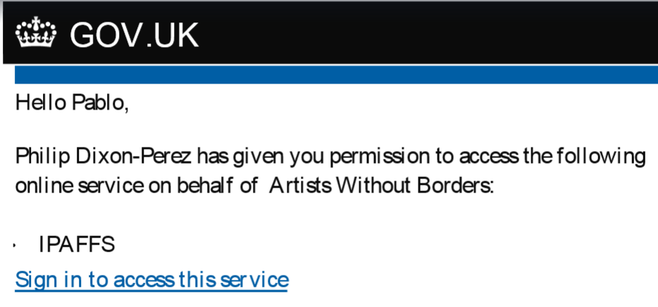
How do I register for IPAFFS? – Standard User
01
Invitation received
Create a Government Gateway Account
Provide Email Details
02
03
Select ‘Create Sign in Details’
Hint: You can only access IPAFFS if you receive an invitation
via email
Hint: Please note your email is unique and can only be
registered once
Hint: Remember the first person to register your organisation
will hold the ‘Org Admin’ position and will be able to invite other
users to your organisation and also to allocate roles.
We highly recommend that you have multiple ‘Org Admins’ within
your organisation
Receive Government Gateway ID
05
Create a Password
Validate Email Details
06
04
Hint: Please check your junk / spam folder if code not received
within 2 hours
Once you have created your recovery word you will receive a unique
Government Gateway ID.
Hint: As with your password you will need to make a note of your Government
Gateway ID (this will be your user ID when logging into IPAFFS) and save in a
secure place
Hint: Remember to make a note of your password and recovery
word as this will be required each time you access IPAFFS

Slide 6
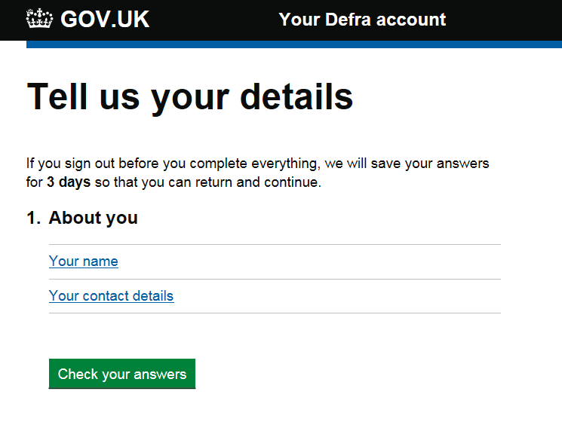
Registrations continued…
07
08
About You
09
Now register for IPAFFS
Notification Dashboard
Hint: Once you have read ‘T&C’s’ and ‘Privacy Notice’ you will then
go on to create your Defra Account
Hint: Once all fields are populated the section will
say ’Completed’
Your dashboard will be displayed and you are now able
to raise and view notifications

